Slide 1
Sprint 2 Progression on Video Game
By: Brian Kollgaard, Joseph Traglia, Emanuel Luna

Slide 2
Current Scope/Overview of Project
Including interactive collision (floor, teleport, non-playable character).
Include left/right character movement.
Have 5-10 minutes of playable gameplay.
Having fully working sound and visuals.
Provide an enjoyable experience.
Maintain accuracy with trailer.

Slide 3
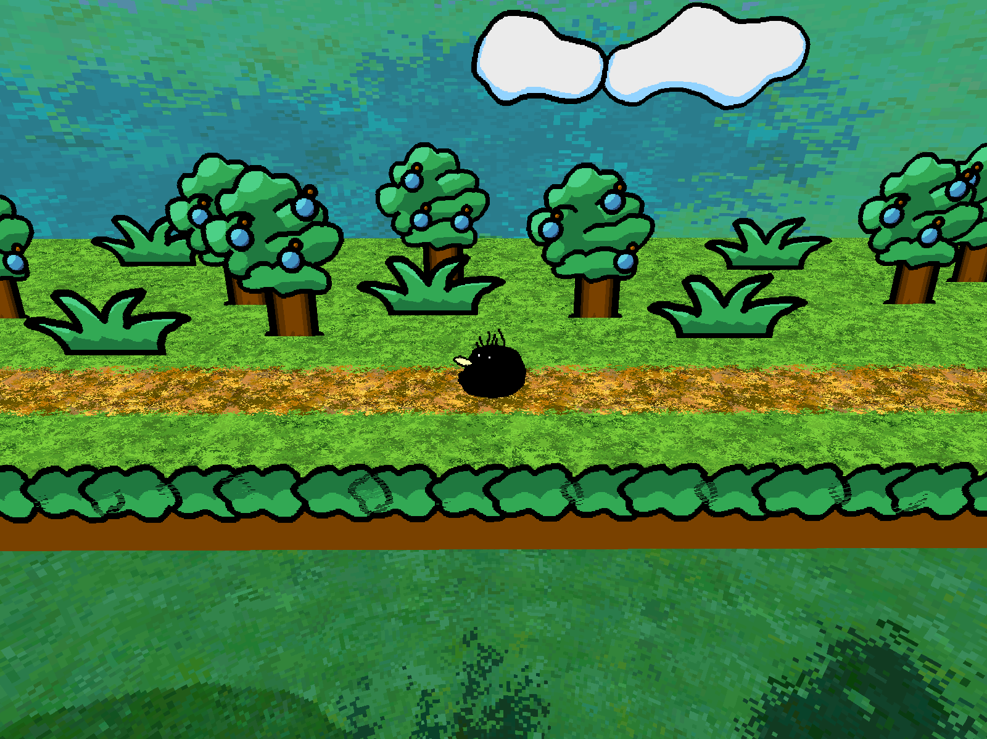

Brian’s Prototype

Slide 4

Emanuel’s Prototype

Slide 5
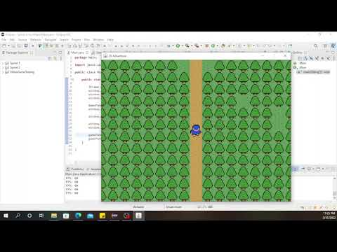
Joseph’s Prototype

Slide 6
Sprint 2 - Completed and Uncompleted
Emanuel Luna
Implementing Textures
Complete
Implement Animations
Incomplete
Implementing Title Screen Music
Incomplete
Joseph Traglia (Scrum Master)
Implementing In-Game Music
Complete
Implementing In-Game Sound Effects
Complete
Implementing Button Sounds
Incomplete
Brian Kollgaard (Team Leader)
Design Background Elements
Incomplete
Animated Background Elements
Incomplete
Make Elements Implementable
Incomplete

Slide 7
Tasks for Sprint 3
Emanuel Luna
Implement Interactivity Within Gameplay (Talking to NPC’s or Killing enemies.
Smoother Animations
Joseph Traglia
Implementing Button Sounds
Implementing Item Counter
Brian Kollgaard
Design Background Elements
Animated Background Elements
Make Elements Implementable

